Slide 1

TITLE OF THE PROJECT
Pay&park

Slide 2


A Project Report On
PAY&PARK MANAGEMENT SYSYEM
BACHELOR OF COMPUTER APPLICATIONS
Of
MANGALORE UNIVERSITY
Under the guidence of By
Prof Prakash Pearel Nazareth 148080606 Lecturer in Computer Science Vijay 148080628
St. Mary’s College, Shirva Sandhya Acharya 148080624
DEPARTMENT OF COMPUTER SCIENCE
ST.MARY’S COLLEGE ,SHIRVA-574116
2016-2017

Slide 3
SYNOPSIS
Title of the project:
The Title of the Project is “Pay&Park”
purpose
The main purpose of this project is to automate all possible functionalities of the parking management
.
Main objective of the project:
The main objective of this project is to introduce an easy and modern parking system which helps customers as well as operators.
We make this system for Private space owners, malls, hotels to calculate vehicle parking bill by entering in-time and out-time.
Even this system helps customer to check nearest parking space and available parking slots.

Slide 4
Problem Analesis:
Existing System:
In the present system parking record of a vehicle entered manually. The employee has to enter all the details by himself.
Proposed System:
Here everything is generated automatically. The employee only enter vehicle number and customer name everything else like entry time and exit time, number of hours and the fees is generated automatically.

Slide 5
MODULES
The program consists of following modules: -
Log in module:
Log in module.
Dashboards:
Dashboard
Employee account
Change password module
Add admin
Add branch
Add employee
Add parking cost
Add parking locations
Add parking slots
Add vehicle types
View admin
View branch
View employee

Slide 6
View parking cost
View parking locations
View parking slots
View vehicle types
Add parking records:
Add parking records
View parking records
Report module:
Branch wise report
Vehicle parking report
Parking income report
Employee wise report
Voucher Module:
Add customer
View customer
Add voucher
View voucher

Slide 7
MODULE DESCRIPTION
Log in module.
In this module, the Administrators and the employees can log in to their dashboards and manage their accounts.
Dashboards.
In this module, the Administrators and Employees can manage their profiles, manage branches, view the records.
Add parking records:
In this module, the employees can add the parking records by selecting vehicle types after selecting vehicle types loading available parking slots then adding the in time of the vehicle and when the vehicle is exiting the are adding the out time .This generates a bill.

Slide 8
Report module:
This module, is for administrator where admin can view various kinds of report. Admin can view :
Branch wise report
Vehicle parking report
Parking income report
Employee wise report
Voucher Module:
This module, a special voucher is created for the customers to avail discounts for the frequently visited customers.
Add customer
View customer
Add voucher
View voucher

Slide 9
Future scope of the project:
We can develop and integrate with Android or iPhone based apps
in the future.
We can integrate a Card payment system in the future.
Hardware Requirement:
Minimum Hardware Configuration of our Project is 512 MB RAM, Windows XP / Windows 7 required & 40 GB hard disk space.
Software Requirement:
Windows Operating System Intel Pentium or above , XAMPP ,& any text editor.
Front End : PHP
Back End : MY SQL

Slide 10

LITERATURE SURVEY

Slide 11
PHP
PHP stands for Hypertext Pre Processor.
PHP is a widely-used open source general-purpose scripting language that is especially suited for web development and can be embedded into html.
Originally created by Rasmus Lerdorf in 1994.
PHP code may be embedded into HTML code, or it can be used in combination with various web template systems and web frameworks.
PHP code is usually processed by a PHP interpreter implemented as a module in the web server or as a Common Gateway Interface (CGI) executables.

Slide 12


Slide 13
MySQL
MySQL is an open-source relational database management system (RDBMS).
Its name is a combination of “My”, the name co-founder Michael Widenius and “SQL” the abbreviation for structured query language.
Information in the MySQL database are stored in the form of related tables.
MySQL database are typically used for web application development.

Slide 14


Slide 15
Java Script
JavaScript (JS) is a dynamic computer programing language. It is most commonly used as part of web browsers, whose implementations allow client-side scripts to interact with the user, control the browser, communicate asynchronously, and later the document content that is displayed. It is also being used in server-side programing, game development and the creation of desktop and mobile applications. JavaScript is a prototype-based language with dynamic typing and has first-class functions.

Slide 16


Slide 17
CSS 3
CSS is a style sheet language used to describe the presentation semantics (that is, the look and formatting) of a document written in markup language (Style defines how to display HTML elements). Its most common application is to style web page written in HTML and any kind of XML documents. Cascading Style Sheets (CSS) are widely recognized for their contribution in building fact-loading, standards compliant, easily modifiable web pages. External Style Sheets are stored in CSS file CSS 3 is the latest standards for CSS. CSS 3 is completely backwards-compatible with earlier versions of CSS. The online Blood Management System uses the CSS3 specifications

Slide 18


Slide 19
HTML 5
HTML stands for Hyper Text Markup Language.
A markup language is a set of markup tags.
HTML markup tags are usually called as HTML tags.
HTML tags are keywords surrounded by angle brackets like <html>.
HTML document contain HTML tags and plain text.
HTML documents are also called as Web Pages.

Slide 20


Slide 21
XAMPP
XAMPP is a free and open source cross-platform web server solution stack package developed by Apache Friends, consisting mainly of the Apache HTTP Server, Maria DB database, and interpreters for scripts written in the PHP and Perl programming languages. XAMPP stands for Cross-Platform (X), Apache (A), Maria DB (M), PHP (P) and Perl (P). It is a simple, lightweight Apache distribution that makes it extremely easy for developers to create a local web server for testing and deployment purposes. Everything needed to set up a web server – server application (Apache), database (Maria DB), and scripting language (PHP) – is included in an extractable file. XAMPP is also cross-platform, which means it works equally well on Linux, Mac and Windows. Since most actual web server deployments use the same components as XAMPP, it makes transitioning from a local test server to a live server extremely easy as well.

Slide 22


Slide 23

SOFTWARE REQUIREMENT SPECIFICATION

Slide 24
Introduction:
Software Requirement Specification (SRS) is the starting point of the software development activity. Software Requirement Specification is focused specifically on the functioning of the system. The basic purpose of the SRS is to build the communication between the parties involved in the development project. It allows developer to understand the system, functions to be carried out.
Purpose:
In the present world almost everything is computerized. So computerization is one of the better ways to maintain the records compared to the manual maintenance. Usually human beings make mistakes during calculation and maintaining the records. This can be avoided by computerizing the whole system.
Through this project we are trying to automate the process of pay&park.

Slide 25
Existing System:
In the present system parking record of a vehicle entered manually. The employee has to enter all the details by himself.
Proposed System:
Here everything is generated automatically. The employee only enter vehicle number and customer name everything else like entry time and exit time, number of hours and the fees is generated automatically.

Slide 26
Specific Requirements Constraints:
Front End : PHP
Back End : MY SQL
Software Requirements:
XAMPP 1.8.2
Apache server
PHP 5.4
MYSQL server 5.5
Adobe Dreamweaver CS 6.0
Hardware Requirements:
Operating system: Windows XP / Windows 7
Hard disk: 40 GB hard disk
RAM : 512 MB RAM
Processor: Intel Pentium or above

Slide 27
User Interfaces:
The software runs on Windows 98 or Windows XP operating systems with only one user command. To make the software user friendly we have taken care of the following requirements during design.
Label Field to enter the details.
Command buttons for Add, Edit, Save, Search, Delete etc
Error messages will display when you enter incorrect details.
Software interface:
Visual basic .Net is rapid Application Development (RAD) tool used to create powerful desktop,client server and internet based window applications. Using visual basic .Net, application can be
created in a fast and easy manner.
Microsoft SQL Server version 7.0 provides a comprehensive platform that makes it easy to design, build, manage which enable your organization to make effective business decisions based on timely and accurate information.
Design Constraints:
The software will be able to work fast and efficiently as each processing is done by individual computers. The software can be run on many systems. Software Requirement Specification (SRS) identifies type of machine, operating system, language supported limits on Security requirements to restrict the use of certain commands control to access data etc.

Slide 28

SYSTEM DESIGN

Slide 29
Introduction :
The purpose of the designing phase is to plan a solution for the problem specified by the requirement document. This phase moves from the problem domain to the solution domain.
Design Methodology:
BS carried out the project using a module driven development. By the input obtained from the customer, analysis of the system and feasibility study, a model of the system is developed and further proceedings are based on the initial model. Changes have been made to the model in frequent intervals, according to need using some standards and the final system developed.
Context Flow Diagram (CFD)
This diagram pictures the system at the center, with no details of its interior structure, surrounding by all its interacting systems and activities. Main objective is to focus on external factors and events.

Slide 31
Data Flow Diagrams:
The data flow diagram is a way of expressing system requirements in a graphical form. A DFD also has known a bubble chart as purpose of clarifying system requirements and identifying major transformations that will become programs in design.
DFD Notations:
PROCESS
DATA FLOW
EXTERNAL ENTITY
DATA STORE
Process:
A circle or a Bubble represents a process that transforms data from one form to another by performing some tasks with the data. The process name must be given a general idea of its function.

Slide 32
Data Flow:
An arrow represents data flow. It represents the path over which data travels in the system. A data flow can move between processes, flow into or out of data stores, to and from external entities. It must be given a name above the arrowhead showing the direction of flow.
External Entity:
A rectangle, which defines the source or destination of system data also called as external entity. An external entity is not responsible for any task performed by the system.
Rules for constructing DFD:
Process should be named for easy understanding.
The direction of flow, top to bottom and from left to right should be specified.
The direction flow should not allow any kind of loops.

Slide 33
LEVEL-1

Slide 34
LEVEL-2

Slide 39

DATABASE DESIGN

Slide 40
Introduction:
Database Design maintains the data required by the System. Database tables used are described in the following sections.
The new database design has been suggested to overcome the non-integration Problems that were in the existing system. The entire system will use single integrated database. This gives the synergism to the system.
Schema Description:
Tablename:admin
Field name | Type | Description | Constraints
admin_id | int(10) | Admin id | Primary key
admin_name | varchar(25) | Admin name | Not null
login_id | varchar(25) | Login id | Not null
password | varchar(100) | Password | Not null
status | varchar(10) | Active or Inactive | Not null

Slide 41
Table name: branch
Field name | Type | Description | Constraints
branch_id | int(10) | Branch id | Primary key
branch_name | varchar(25) | Branch name | Not null
branch_details | text | Branch details | Not null
address | text | Address | Not null
contact_no | varchar(15) | Contact no | Not null
status | varchar(10) | Active or Inactive | Not null
Table name: customer
Field name | Type | Description | Constraints
customer_id | int(10) | Customer id | Primary key
customer_name | varchar(25) | Customer name | Not null
mobile_no | varchar(10) | Mobile no | Not null
address | text | Address | Not null
vehicle_no | int(10) | Vehicle no | Foreign key
Table name: employee
Field name | Type | Description | Constraints
employee_id | int(10) | Employee id | Primary key
emp_name | varchar(25) | Employee name | Not null
branch_id | int(10) | Branch id | Foreign key
login_id | varchar(20) | Login id | Not null
password | varchar(100) | Password | Not null
mob no | varchar(15) | Mobile no | Not null
status | varchar(10) | Active or Inactive | Not null

Slide 42
Table name: parking_cost
Field name | Type | Description | Constraints
parking_cost_id | int(10) | Parkingcost id | Primary key
parking_slot_id | int(10) | Parkingslot id | Foreign key
no_of_hours | int(10) | No of hours | Foreign key
cost | float(10,2) | Cost | Foreign key
status | varchar(10) | Active or Inactive | Not null
Table name: parking location
Field name | Type | Description | Constraints
parking_location_id | int(10) | Parking location id | Primary key
parking_location | varchar(10) | Parking location | Not null
branch_id | int(10) | Branch id | Foreign key
location_img | varchar(10) | Location image | Not null
location_address | text | Location address | Not null
status | varchar(10) | Status | Not null

Slide 43
Table name: parking record
Field name | Type | Description | Constraints
parking_record_id | int(10) | Parking record id | Primary key
receipt_no | int(10) | Receipt no | Foreign key
bill_no | int(10) | Bill no | Foreign key
in_date_time | datetime | In date time | Not null
out_date_time | datetime | Out date time | Not null
vehicle_type_id | int(10) | Vehicle type id | Foreign key
parking_location_id | int(10) | Parking location id | Foreign key
parking_slot_id | int(10) | Parking slot id | Foreign key
parking_cost_id | int(10) | Parking cost id | Foreign key
employee_id | int(10) | Employee id | Foreign key
total_cost | float(10,2) | Total cost | Foreign key
vehicle_no | varchar(25) | Vehicle no | Not null

Slide 44
Table name: parking slot
Field name | Type | Description | Constraints
parking_slot_id | int(10) | Parking slot id | Primary key
vehicle_type_id | int(10) | Vehicle type id | Foreign key
parking_location_id | int(10) | Parking location id | Foreign key
number_of_slots | int(10) | Number of slot | Foreign key
status | varchar(10) | Active or Inactive | Not null
Table name: vehicle type
Field name | Type | Description | Constraints
vehicle_type_id | int(10) | Vehicle type id | Primary key
vehicle_type | varchar(25) | Vehicle type | Not null
vehicle_icon | varchar(100) | Vehicle icon | Not null
status | varchar(10) | Active or Inactive | Not null
Table name: voucher
Field name | Type | Description | Constraints
voucher_id | int(10) | Voucher id | Primary key
customer_id | varchar(10) | Customer id | Foreignkey
voucher_no | varchar(10) | Voucher no | Foreign key
status | varchar(10) | Active or Inactive | Not null

Slide 45
Table name: voucher transaction
Field name | Type | Description | Constraints
vouher_transaction_id | int(10) | Voucher transaction id | Primary key
transaction_type | varchar(10) | Transaction type | Not null
transaction_amt | float(10,2) | Transaction amount | Foreign key
trans_date | date | Transaction date | Not null
parking_record_id | int(10) | Parking record id | Foreignkey
note | text | Note | Not null
status | varchar(10) | Active or Inactive | Not null

Slide 46
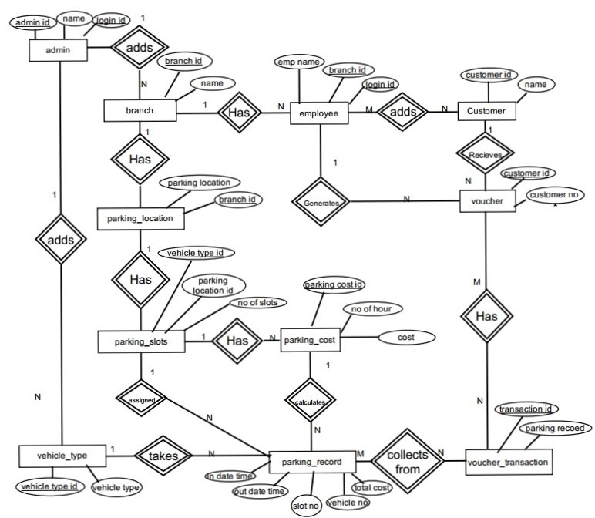
ER-DIAGRAM

Slide 47

DETAILED DESIGN

Slide 48
Registration Form:
Begin
If (click on signup) then
Check for the null values and other invalid entries if all are valid then save it to the database
Else
Display message “invalid”
End if
Else
Generate unique userid and store data in database
End if
End

Slide 49
Structured English:
Login Form:
Begin
If (click on OK) then
Check the username and password, if the user exists then redirect into main form
Else if (user does not exists) then
Display message “Invalid Username” or “Invalid password”
End if
End

Slide 50
Add admin:
Begin
If (click on add record) then
Check for the null values and other invalid entries if all are valid then save it to the database
Else
Display message “invalid “
End if
End
Add employee:
Begin
If (click on add record) then
Check for the null values and other invalid entries if all are valid then save it to the database
Else
Display message “invalid “
End if
End
Add branch:
Begin
If (click on add record) then
Check for the null values and other invalid entries if all are valid then save it to the database
Else
Display message “invalid “
End if
End

Slide 51
Add parking location:
Begin
If (click on add record) then
Check for the null values and other invalid entries if all are valid then save it to the database
Else
Display message “invalid “
End if
End
Add vehicle type:
Begin
If (click on add record) then
Check for the null values and other invalid entries if all are valid then save it to the database
Else
Display message “invalid “
End if
End
Add parking slots:
Begin
If (click on add record) then
Check for the null values and other invalid entries if all are valid then save it to the database
Else
Display message “invalid “
End if
End

Slide 52
Add parking record:
Begin
If (select parking location) then
Show vehicle type
If (select vehicle type) then
Show the parking slots
If (select a slot which is not previously selected) then
Show a pop of window to enter vehicle number & customer name
If (click on submit) then
Check for the null values and other invalid entries if all are valid then save it to the database
Else
Display message “invalid “
End if
End
Exist vehicle:
Begin
If (clicked parked slot) then
Calculate number of hours’ total cost and display it to the user
If (clicked confirm exit) then
Print the bill and make the slot available for parking the next vehicle

Slide 53
Add feedback:
Begin
If(click on feedback) then
Check for the null values and other invalid entries if all are valid then save it to the database
Else
Display message “invalid “
End if
End

Slide 54
System Testing

Slide 55
Psychology of Testing:
The aim of testing is often to demonstrate that a program works by showing that it has no errors. The basic of testing phase is to detect the errors that may be present in the program hence one should not start testing with the intent to show that a program doesn’t work. Testing is the process of executing a program with the intent of finding errors.
Testing objectives:
The main objective of testing is to cover a host of errors, systematically and with minimum effort and time. Starting formally, we can say, testing is a process of executing a program with the intent of finding an error.

Slide 56
A successful test is one that uncovers an as yet undiscovered error
A good test case is one that has a high probability of finding an error, if it exists.
The tests an inadequate to detect possibly present errors
The software more or less confirms to the quality and reliable standards.
Levels of testing:
Unit testing
Integration testing
Validation testing
Output testing

Slide 57
Unit Testing:
Unit testing focuses verification effort on the smallest unit of software i.e. the module. Using detailed design and the process specification testing is done to uncover errors within the boundary of the module all the modules must be successful in the unit test before the start of integration testing begins.
Integration testing:
In integration testing all the code modules are put together and tested for desired outputs. The modules unit tested are integration and tested. All the modules are combined in this resting step. Then the entire program is tested as whole. The integration testing is done.

Slide 58
Output Testing:
Feeding sample valid input image and then comparing the ratio obtained in the compressed output image with expected ratio conduct it. Correctness of the output depends on the inputted image.
System testing:
In system testing entire system is tested as whole with all forms, code modules and class modules. After the integration testing the whole of the system is tested in different environments and it is found that the system well without giving any runtime error. Hence after the testing it is concluded that the system will work fine in all environments.

Slide 59
Test case 1:
Objective: test for login form
Test data: Valid: valid username and password to enter the program.
Invalid: when entered invalid username and password
Output: Valid: logged in successfully
Invalid: show the error message
Result: Valid: the admin/employee can enter the program.
Invalid: the user is prompt with an error message and restricted to enter the system
Conclusion: both valid and invalid results are tested. output tally with the required result hence the test is successful.
Test case 2:
Objective: test for add admin, parking cost form
Test data: Valid: all the required fields are entered.
Invalid: some fields are blank or contain invalid data
Output: Valid: Allows to insert the record
Invalid: displays an error message to help the user understand the mistake
Result: Valid: record will be added to database.
Invalid: record will be not added to database.
Conclusion: both valid and invalid results are tested. output tally with the required result hence the test is successful.

Slide 60
Test case 3:
Objective: test for add customer
Test data: Valid: all the required fields are entered.
Invalid: some fields are blank or contain invalid data
Output: Valid: Allows to insert the record
Invalid: displays an error message to help the user understand the mistake
Result: Valid: record will be added to database.
Invalid: record will be not added to database.
Conclusion: both valid and invalid results are tested. output tally with the required result hence the test is successful.
Test case 4:
Objective: test for add branch
Test data: Valid: all the required fields are entered.
Invalid: some fields are blank or contain invalid data
Output: Valid: Allows to insert the record
Invalid: displays an error message to help the user understand the mistake
Result: Valid: record will be added to database.
Invalid: record will be not added to database.
Conclusion: both valid and invalid results are tested. output tally with the required result hence the test is successful.

Slide 61
Test case 5:
Objective: test for add employee
Test data: Valid: all the required fields are entered.
Invalid: some fields are blank or contain invalid data
Output: Valid: Allows to insert the record
Invalid: displays an error message to help the user understand the mistake
Result: Valid: record will be added to database.
Invalid: record will be not added to database.
Conclusion: both valid and invalid results are tested. output tally with the required result hence the test is successful.
Test case 6:
Objective: test for entering vehicle record form
Test data: Valid: empty slot is selected
Invalid: selected occupied slot
Output: Valid: Allows to insert the record
Invalid: displays an error message to help the user understand the mistake
Result: Valid: record will be added to database.
Invalid: record will be not added to database.
Conclusion: both valid and invalid results are tested. output tally with the required result hence the test is successful.

Slide 62
Test case 7:
Objective: test for add vehicle type
Test data: Valid: all the required fields are entered.
Invalid: some fields are blank or contain invalid data
Output: Valid: Allows to insert the record
Invalid: displays an error message to help the user understand the mistake
Result: Valid: record will be added to database.
Invalid: record will be not added to database.
Conclusion: both valid and invalid results are tested. output tally with the required result hence the test is successful.
Test case 8:
Objective: test for add parking location
Test data: Valid: all the required fields are entered.
Invalid: some fields are blank or contain invalid data
Output: Valid: Allows to insert the record
Invalid: displays an error message to help the user understand the mistake
Result: Valid: record will be added to database.
Invalid: record will be not added to database.
Conclusion: both valid and invalid results are tested. output tally with the required result hence the test is successful.

Slide 63
Test case 9:
Objective: test for add parking slots
Test data: Valid: all the required fields are entered.
Invalid: some fields are blank or contain invalid data
Output: Valid: Allows to insert the record
Invalid: displays an error message to help the user understand the mistake
Result: Valid: record will be added to database.
Invalid: record will be not added to database.
Conclusion: both valid and invalid results are tested. output tally with the required result hence the test is successful.
Test case 10:
Objective: test for add employee
Test data: Valid: all the required fields are entered.
Invalid: some fields are blank or contain invalid data
Output: Valid: Allows to insert the record
Invalid: displays an error message to help the user understand the mistake
Result: Valid: record will be added to database.
Invalid: record will be not added to database.
Conclusion: both valid and invalid results are tested. output tally with the required result hence the test is successful.

Slide 64

SNAPSHOTS

Slide 65
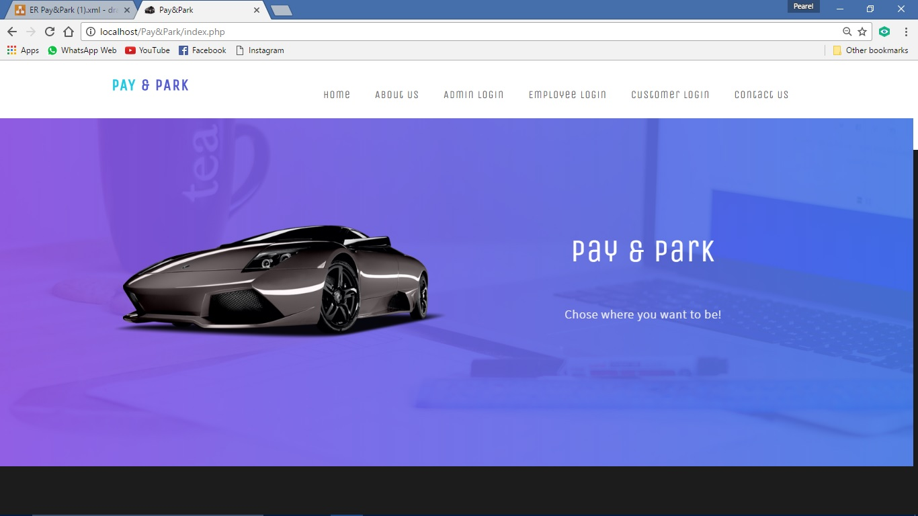
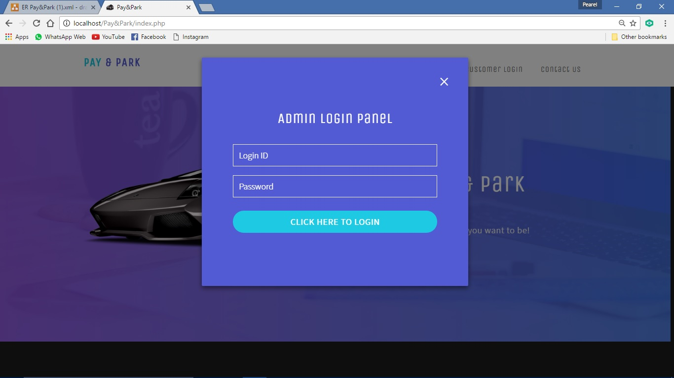
Index Page:
Admin login:

Slide 66
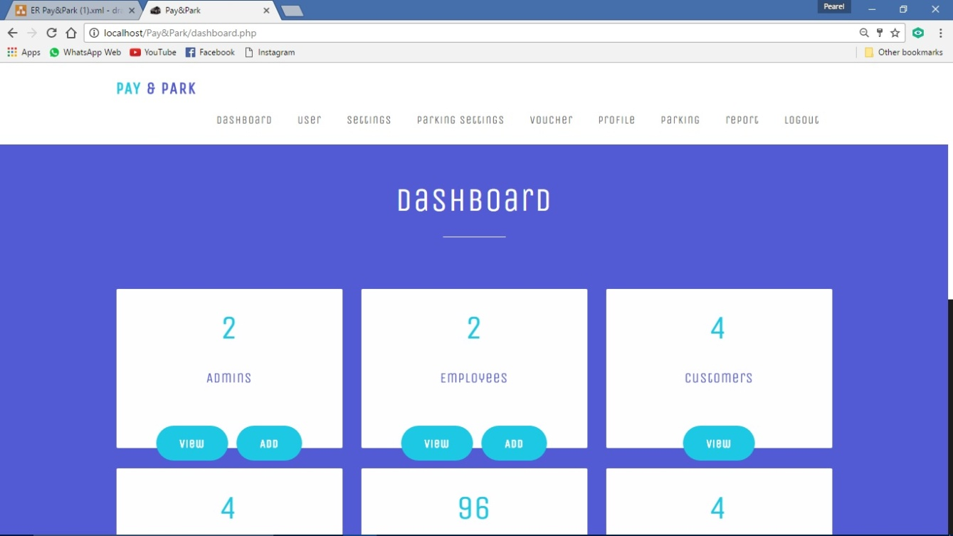
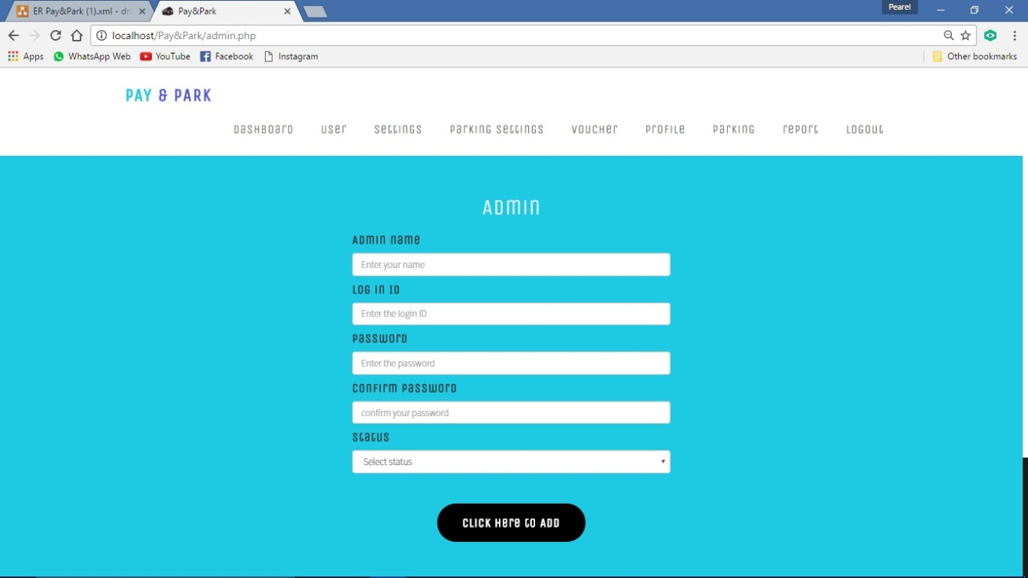
Dash board:
Add admin:

Slide 67
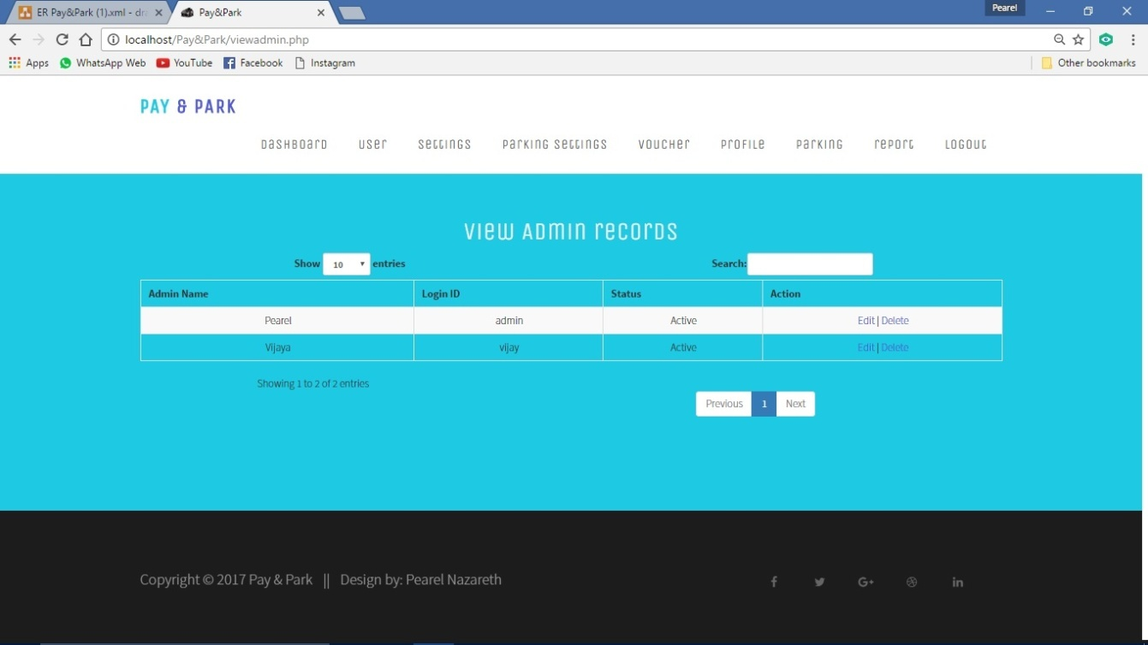
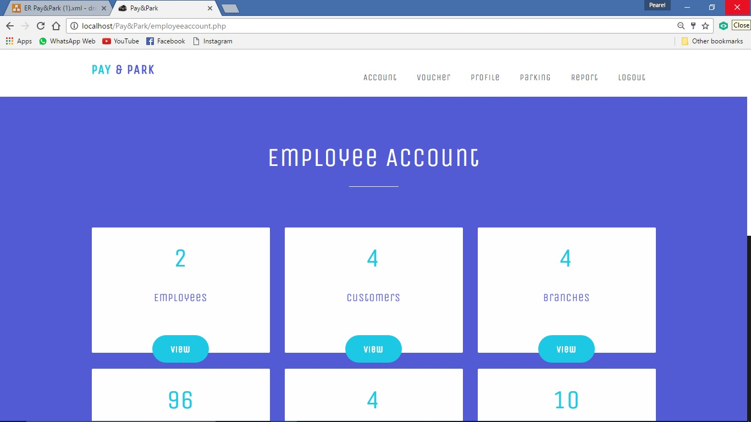
View admin:
Employee account:

Slide 68
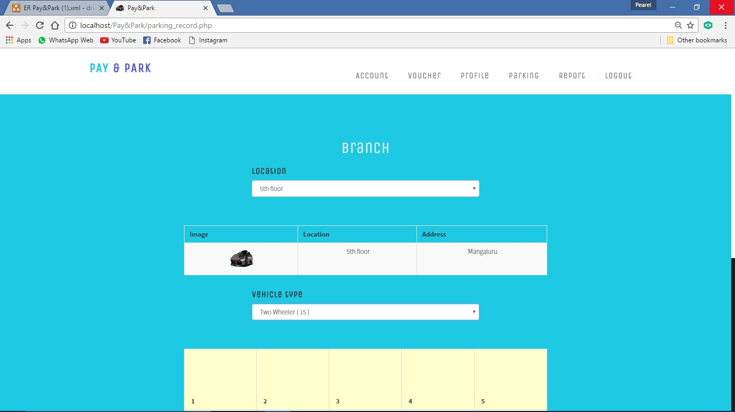
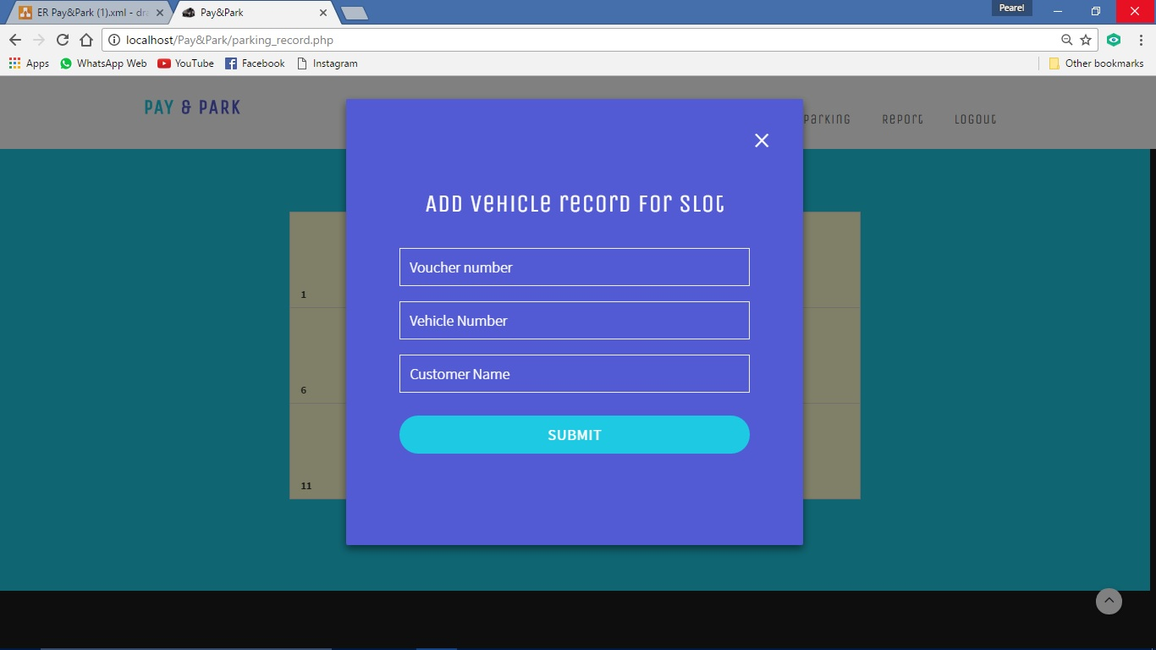
Add parking record:
Adding parking record:

Slide 69
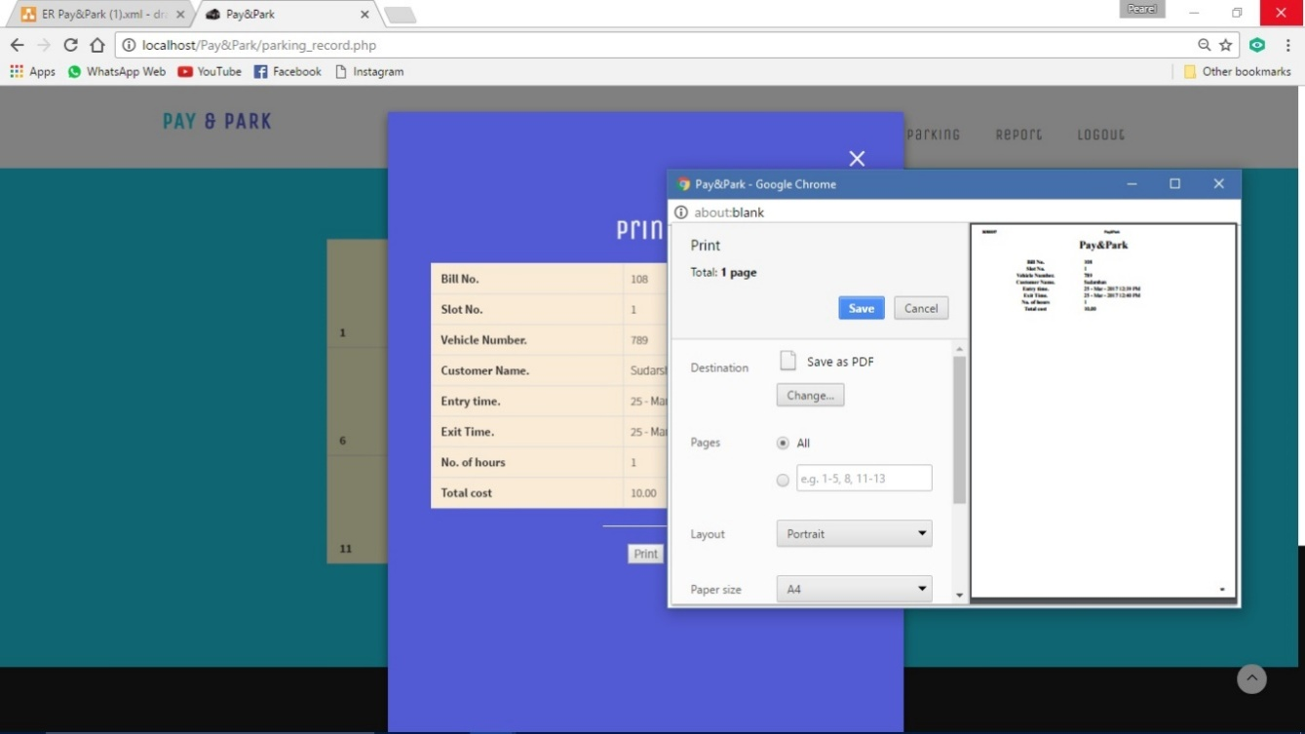
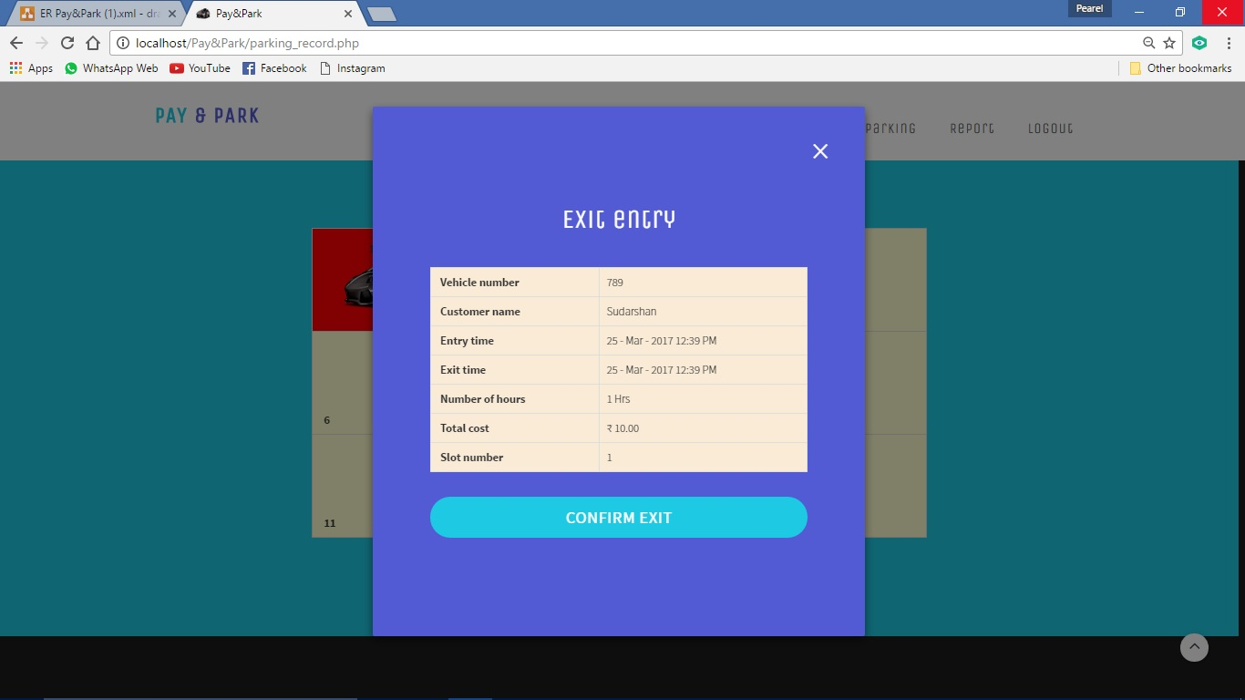
Printing bill:
Exit vehicle:

Slide 70

Conclusion and future enhancement

Slide 71
Conclusion:
“PAY&PARK” is developed for the purpose of computerizing and maintaining the parking system. Before the records were inserted manually but in the pay& park management system all the work is automated, where employee enters a couple of things and other things like entry time is inserted automatically. When the vehicle exits employee only enters slot number, other things like exit time and parking fees generated automatically and the slot is freed. This helps to maintain the records efficiently.
Future Enhancement:
Add more security features.
We can consider much future scope to this application. The following are some of these.
In future, we can further enhance this software for tablets and mobile phones.
Later basis software is developed as friendly and attractive
We can develop and integrate with Android or iPhone based apps in the future.
We can integrate a Card payment system in the future.

Slide 72
Limitations

Slide 73
Limitations:
The user should have the basic knowledge of computer.
Only the administrator will administer the system.
It can be accessed over the internet
Employee can only view the records.

Slide 74
Bibliography

Slide 75
ST.MARY’S COLLEGE
Book references:
An Integrated Approach To Software Engineer
By:Pankaj jallote
HTML and CSS made simple
By: ivan Bayross
Web reference:
www.w3schools.com
www.phptutorials.com
www.stackoverflow.com

